Slide 1
CSCI 558L Lecture 11: Intro to Network Processors
Internetworking and Distributed Systems Laboratory
Young Cho
Department of Computer Science
University of Southern California

Slide 2
A Typical NP Architecture
Physical
Interface
Network
DMA/Buffer
General
Purpose
Processor
Coproc
Interface
Network
(i.e. GbE)
Internal BUS
Memory
Memory
Interface
DMA/BUS
Interface
Coproc
To main BUS (i.e. PCI-Express)

Slide 3
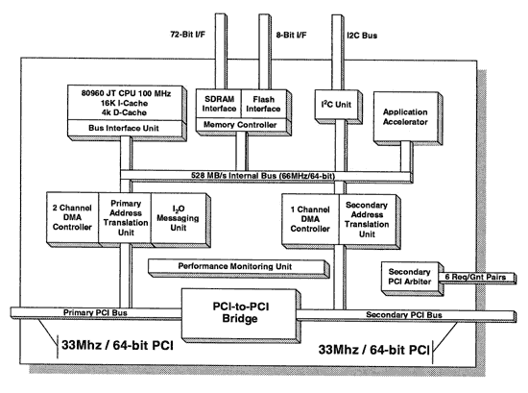
Intel i960

Slide 4
Intel i960
Embedded Processor
I/O Processor
Peer-to-peer
Network Processor
PCI Interface
One to the Main BUS
Other to the Network Interface
Similar to Myrinet LANai
Further development leading into IXA?

Slide 5
Intel IXA
Current Routers
Involve general purpose CPUs
Lots of ASICs (Application Specific Integrated Circuits ).
The ASICs are necessary to keep up with the quantity and rate of the network traffic.
The StrongARM Core
Replace the general purpose CPUs
Microengines
Replace the bulk of the ASICs
Actually inherited IXA when they bought Digital.

Slide 6
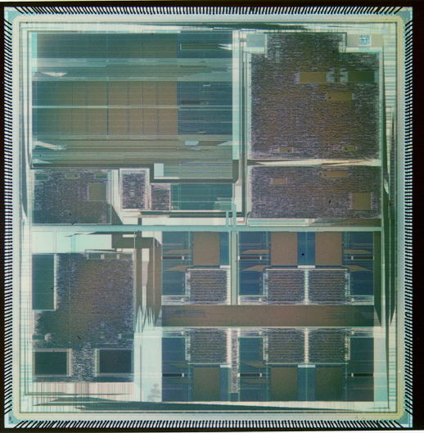
Intel IXP1200 NP
Very Low Power Parallel Processor Architecture with 7 232 MHz RISC processors
Hardware Based Multithreading on 6 RISC engines - Cost Effective
Distributed Data Storage Arch Supports Very Simple Programming Model
Active Memory Optimizations - High Performance With Commodity RAMs
Scalable Architecture
StrongARM Core
PCI
PCI
SRAM
SRAM
SDRAM
SDRAM
IX Bus
IX Bus
6 RISC Engines
Notes:
This foil highlights the features of the IXP1200 which also exist in the IXP1240 and IXP1250 NPs
The wide range of packet handling and control functionality integrated into the IXP1200 Network Processor enables equipment developers to focus on development of new features and services

Slide 7
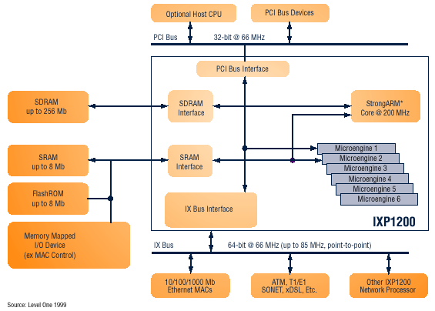
Intel IXP 1200 Block Diagram

Slide 8
IXP2400 Features
Interface supports UTOPIA 1/2/3, SPI-3 (POS-PL3), and CSIX.
Four independent, configurable, 8-bit channels with the ability to aggregate channels for wider interfaces.
Media interface can support channelized media on RX and 32-bit connect to Switch Fabric over SPI-3 on TX (and vice versa) to support Switch Fabric option.
Two Quad Data Rate SRAM channels.
A QDR SRAM channel can interface to Co-Processors.
One DDR DRAM channel.
PCI 64/66 Host CPU interface.
Flash and PHY Mgmt interface.
Dedicated inter-IXP channel to communicate fabric flow control information from egress to ingress for dual chip solution.
Host
CPU
(Optional)
Classification Accelerator
QDR SRAM
20 Gbps
32 M Byte
IXP2400
(Receive)
DDR DRAM
2 GByte
Micro-Engine
Cluster
Customer ASICs
IXP2400
(Transmit)
Flash
Utopia 1/2/3 or
POS-PL2/3
Interface
Switch Fabric Port Interface
ATM / POS PHY
or Ethernet MAC

Slide 9
Microengine V2
From Next Neighbor
D-Push Bus
S-Push Bus
Control
Store
4K
Instructions
Local
Memory
128
GPR
128
GPR
128 Next
Neighbor
128 D
Xfer In
128 S
Xfer In
LM Addr 1
2 per CTX
LM Addr 0
P-Random #
A_Operand
B_Operand
CRC Unit
CAM
Multiply
Execution Data path
CRC remain
Find first bit
Local
CSRs
Add, shift, logical
ALU_Out
To Next Neighbor
128 D
Xfer Out
128 S
Xfer Out
D-Pull Bus
S-Pull Bus

Slide 10
IXP 2400
Eight next generation Microengines (MEv2)
Operating at 600MHz
Automated packet scheduling and handling
Local data store enables higher performance
Hardware acceleration for DiffServ, MPLS, and other QoS schemes
ATM Segmentation and Reassembly (SAR) support with headroom.
Intel® XscaleTM microarchitecture core operating at 600MHz

Slide 11
Myrinet
Processor on Myrinet NIC
Leading Interface card for Clustering
Offload Network processing from main Processor
One of the first “Network Processor”
Pipelined RISC processor
General Purpose Processor
Fully functional GCC with libraries
Interfaces
Network (Myrinet – High BW/Low Latency)
SRAM Memory Interface
BUS Interface

Slide 12
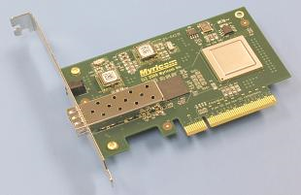
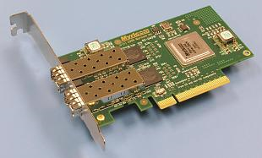
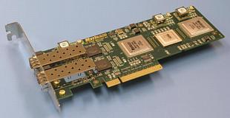
Myrinet Cards

Slide 13
Summary for Myrinet
Physical Links are 10-Gigabit Ethernet
10+10 Gigabits per second, full-duplex.
Converted to other 10-Gigabit Ethernet PHYs.
At the Data-Link level, the links may be either Ethernet or Myrinet
Software support
MX-10G is the low-level message-passing system for the Myri-10G
Includes ethernet emulation (TCP/IP, UDP/IP)
10-Gigabit Ethernet drivers (A matter of Firmware)
Performance with the Myri-10G PCI-Express NICs
Myrinet mode: 2µs MPI latency with 1.2 GBytes/s one-way
10-Gigabit Ethernet mode, 9.6 Gbits/s TCP/IP rate

Slide 14
Phase-1: Single Core Network Processor
IF/
ID
ID/
EX
EX/
MEM
MEM/WB
REGISTER FILE
PC
ALU
INSTR MEMORY
FIFO MEMORY
DATA MEMORY

Slide 15
Phase-2: 4-Threaded Single Core NP
T0
T1
Data Path
T2
T3

Slide 16
Phase-3: 8-Threaded Dual Core NP
Instruction
Memory
T0
T1
Core-0 Data Path
T2
T3
T0
T1
Core-1 Data Path
T2
T3

Slide 17
Phase-2: FIFO Control Machine
4-Threaded Single Core Processor
FR0
Incoming Packet
Internal FIFO Control Machine
T0
PD0
FIFO Control Machine
FIFO Ready
FR1
T1
PD1
Process Done
FR2
T2
PD2
FR3
Outgoing Packet
T3
PD3

Slide 18
Phase-3: FIFO Control Machine
Core-0
Incoming Packet
FIFO Ready – C0
FIFO Control Machine
Process Done – C0
FIFO Ready – C1
Core-1
Process Done – C1
Outgoing Packet

Slide 19
Fine-Grain Multithreading
IP & MAC based filtering
IF/
ID
ID/
EX
EX/
MEM
MEM/WB
Application
based filtering
Generate Traffic Statistics
Manage IDS

Slide 20
Port Based Filtering : Datapath
# R2 is already loaded with 0000 0000 FFFF 0000
ANDF R1 R2 5
IF/
ID
ID/
EX
EX/
MEM
MEM/WB
REGISTER FILE
PC
ALU
INSTR MEMORY
FIFO MEMORY
DATA MEMORY
Notes:
# R2 is already loaded with 0000 0000 FFFF 0000
I: ANDF R1 R2 FIFO[5]

Slide 21
Design Specification
8-Threaded Dual Core Network Processor with Accelerators
Clock speed of a core is approximately 80MHz
Up to 4Gbps line speed
Drop packets
Software-implemented filters
Intrusion Detection System
Ping, Iperf, Modify packets

Slide 22
Laboratory 6 Discussion
Building a custom IP Router
Base System Using Socket/Libpcap (capture)
Longest Prefix Matching
IP Header Updates (TTL and Checksum)
ICMP response
Performance measurements
Two sub-teams
Build independently for the first week
First week will be graded based on about 50% of the tasks
Merge results on second week
May want to distribute tasks between 2 subteams
Due Oct 15 at 11:55pm

Slide 23
Next
Next Lecture
Hardware Accelerated Network Appliances
Laboratory
Lab 6: Due on Oct 15 at 11:55pm
Reading Assignment
Watson, G., "NetFPGA: A Tool for Network Research and Education", 2nd Workshop on Architecture Research using FPGA Platforms (WARFP) February, 2006.

